Slide 1
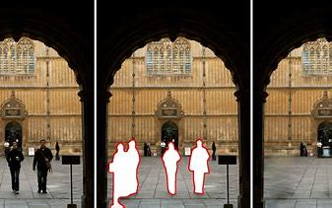
IMAGE INPAINTING USING THE SMOOTH ORDERING OF ITS PATCHES (SOP): TWO NEW APPLICATIONS
Daniel García Perez, Marta Lourdes Baguer Díaz-Romañach, Manuel Vilas Valiente
ACA 2024

Slide 2

INPAINTING OR IMAGE RESTORATION PROBLEM
Given an image with incomplete or corrupted pixels, you want to recover them
$$z=My$$
Features:
Ill-posed problem
How to determine if the solution is a good one?
ACA 2024

Slide 3
STATE OF THE ART
Fast marching method (2004)
Methods based on PDEs (2000-2001)
Texture Synthesis (1981-2001)
Works making use of patches:
Based on the NL-Means algorithm (2005).
Searching for a sparse representation (2006 - 2010)
Making use of a wavelet transform (1998).
Work carried out in our faculty:
By means of clustering algorithms (2015).
Using non-negative matrix factorizations (2018)
Using neural networks (2020)
ACA 2024

Slide 4
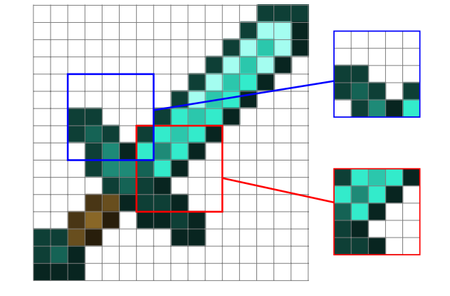
PATCHES AND THEIR CENTERS
A patch is a subimage (submatrix) of dimension √(𝑛 )x √(𝑛 ).
The central pixel or element of a patch is the one that is in a pre-set position for all patches in an image.
ACA 2024

Slide 5
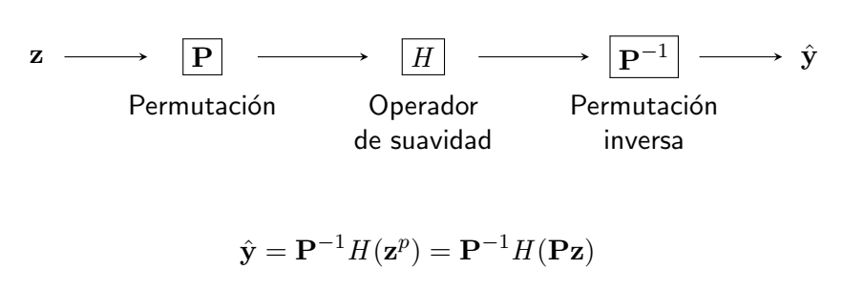

GENERAL PROCEDURE
Notación:
$z$: forma de vector de la matriz (imagen) $Z$ a recuperar.
$\hat{y}$: forma de vector de la matriz (imagen) $\hat{Y}$restaurada.
$Z$ of $N_{1}$ x $N_{2}=N z of N x 1 P of N x N$
ACA 2024

Slide 6

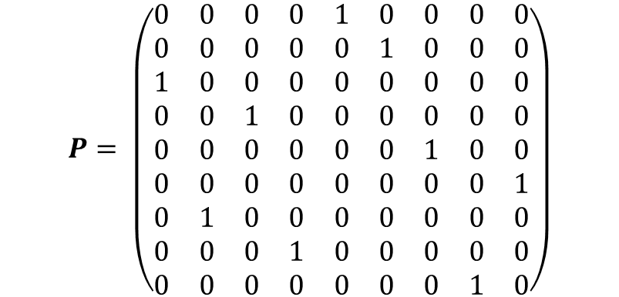
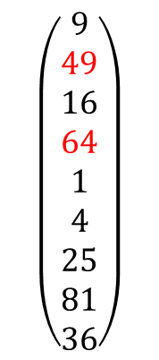
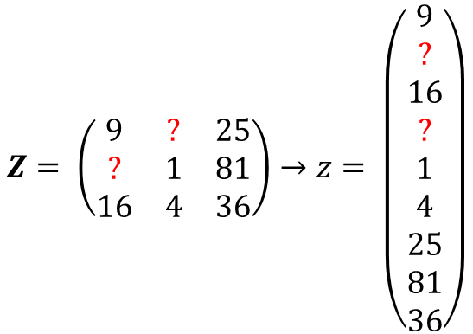
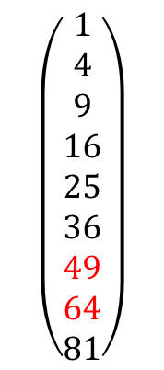

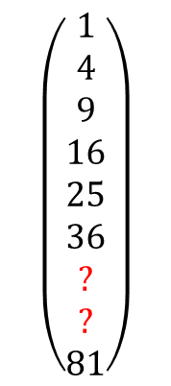

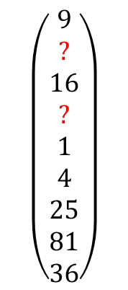

EXAMPLE
$$Z= \left(\begin{matrix}9 & ? & 25 \\ ? & 1 & 81 \\ 16 & 4 & 36\end{matrix}\right)→z= \left(\begin{matrix}9 \\ ? \\ 16 \\ ? \\ 1 \\ 4 \\ 25 \\ 81 \\ 36\end{matrix}\right)$$
$$P= \left(\begin{matrix}0 & 0 & 0 & 0 & 1 & 0 & 0 & 0 & 0 \\ 0 & 0 & 0 & 0 & 0 & 1 & 0 & 0 & 0 \\ 1 & 0 & 0 & 0 & 0 & 0 & 0 & 0 & 0 \\ 0 & 0 & 1 & 0 & 0 & 0 & 0 & 0 & 0 \\ 0 & 0 & 0 & 0 & 0 & 0 & 1 & 0 & 0 \\ 0 & 0 & 0 & 0 & 0 & 0 & 0 & 0 & 1 \\ 0 & 1 & 0 & 0 & 0 & 0 & 0 & 0 & 0 \\ 0 & 0 & 0 & 1 & 0 & 0 & 0 & 0 & 0 \\ 0 & 0 & 0 & 0 & 0 & 0 & 0 & 1 & 0\end{matrix}\right)$$
$$\left(\begin{matrix}9 \\ ? \\ 16 \\ ? \\ 1 \\ 4 \\ 25 \\ 81 \\ 36\end{matrix}\right)$$
$$\left(\begin{matrix}1 \\ 4 \\ 9 \\ 16 \\ 25 \\ 36 \\ ? \\ ? \\ 81\end{matrix}\right)$$
$$\left(\begin{matrix}1 \\ 4 \\ 9 \\ 16 \\ 25 \\ 36 \\ 49 \\ 64 \\ 81\end{matrix}\right)$$
$$\left(\begin{matrix}9 \\ 49 \\ 16 \\ 64 \\ 1 \\ 4 \\ 25 \\ 81 \\ 36\end{matrix}\right)$$
$$z$$
$$Pz=z^{p}$$
$$H(z^{p})$$
$$P^{−1}H\left(z^{p}\right)=\hat{y}$$
ACA 2024

Slide 7
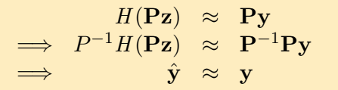
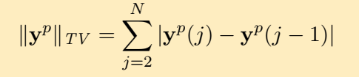
QUESTIONS THAT MATTER
What validates its performance?
Smoothness of a signal?
Which smoothness operator can be used?
Piecewise polinomial interpolation (cubic splines)
How to obtain the P (permutation) matrix?
It is not possible a priori, it is unknown….
ACA 2024

Slide 8

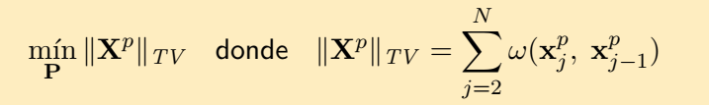
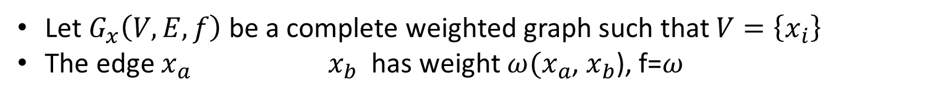
HOW TO OBTAIN THE P MATRIX?
Using the patches
Solve:
Let $G_{x}\left(V,E,f\right)$be a complete weighted graph such that $V=\left\{x_{i}\right\}$
The edge $x_{a}$ ${ x}_{b}$ has weight $ω(x_{a}$, $x_{b}$), f=$ω$
Solve: Variant of TSP (Travelling Salesman Problem) in $G_{x}$
ACA 2024
Notes:
The Traveling Salesman Problem (TSP) is a classic challenge in the field of combinatorial optimization. It is posed as follows: given a set of cities and the distances between each pair of cities, what is the shortest possible route that visits each city exactly once and returns to the starting point? This problem is NP-Hard, which means that there is no efficient algorithm to solve it in all cases. However, numerous heuristics and approximate methods have been developed to deal with specific instances of the TSP, includingHowever, numerous heuristics and approximate methods have been developed to deal with specific instances of the TSP, even when they involve hundreds or thousands of cities1 .A complete graph is a simple undirected graph in which each pair of distinct vertices is connected by a single edge.Some heuristic techniques applied to TSP:Genetic Algorithms (GA): Inspired by biological evolution, GAs generate populations of solutions and combine them to obtain better solutions over time.Simulated Annealing: Based on the metal cooling process, this method searches for solutions by exploring the search space and accepting changes even if they make the current solution worse.Ant Colony: Inspired by ant behavior, this algorithm simulates how ants find optimal paths to food sources.Búsqueda Tabú: Evita quedar atrapado en soluciones subóptimas mediante la exploración de vecindarios y manteniendo una lista de movimientos “tabú”.
GRASP (Greedy Randomized Adaptive Search Procedure): Combina enfoques aleatorios y constructivos para encontrar soluciones prometedoras.
Recuerda que estos métodos pueden no garantizar la solución óptima, pero son útiles para resolver el TSP de manera eficiente.
Tabu Search: Avoids getting trapped in suboptimal solutions by exploring neighborhoods and maintaining a list of "tabu" moves.GRASP (Greedy Randomized Adaptive Search Procedure): Combines randomized and constructive approaches to find promising solutions.Remember that these methods may not guarantee the optimal solution, but they are useful for solving the TSP efficiently.

Slide 9
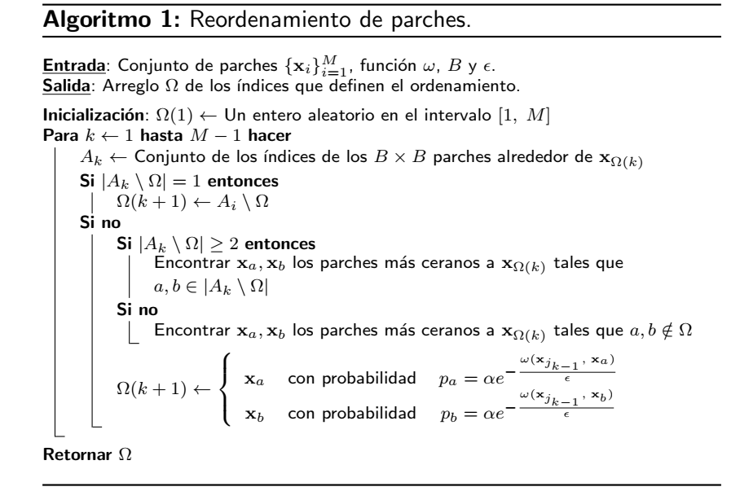
SOLVING THE TSP PROBLEM
ACA 2024

Slide 10

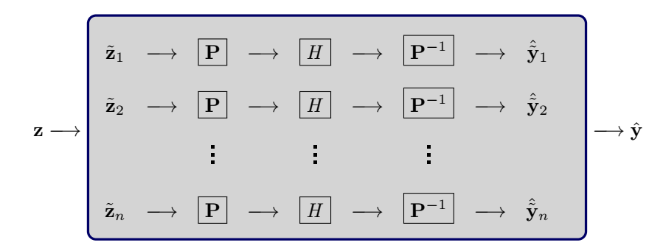

SCHEME WITH SUB-IMAGES
Number of patches of $Z$
Restoring a sub-image
ACA 2024

Slide 11
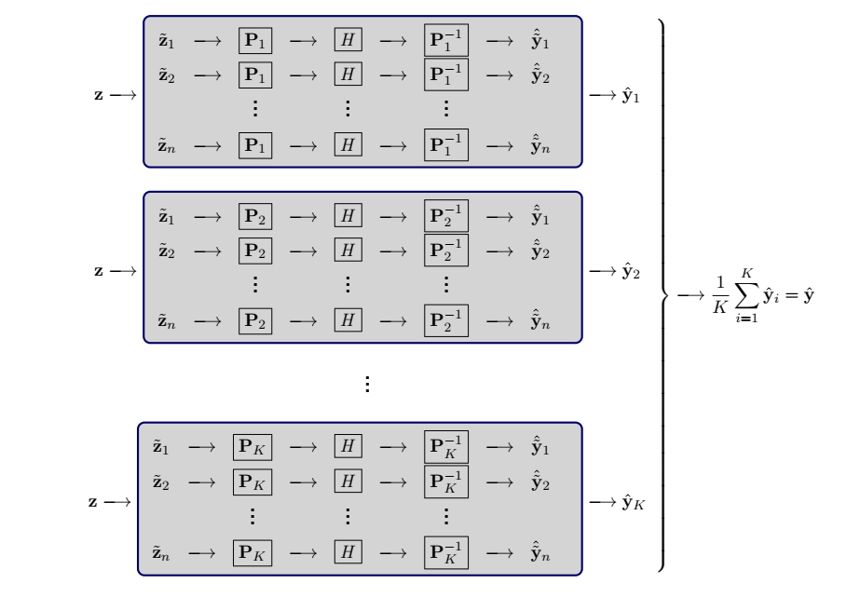
FINAL SCHEME
ACA 2024

Slide 12
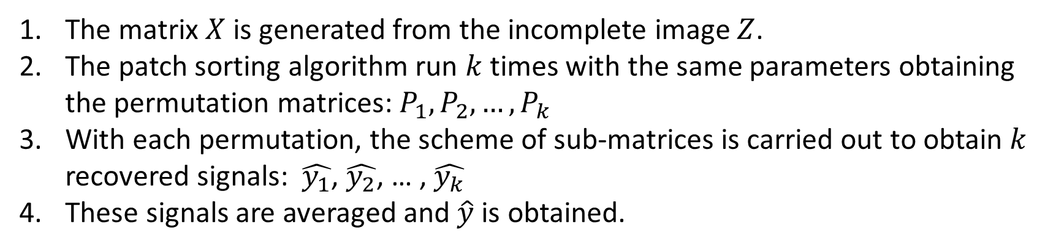
FINAL SCHEME
The matrix $X$ is generated from the incomplete image $Z$.
The patch sorting algorithm run $k$times with the same parameters obtaining the permutation matrices: $P_{1}, P_{2}, …,P_{k}$
With each permutation, the scheme of sub-matrices is carried out to obtain $k$ recovered signals: $\hat{y_{1}}$, $\hat{y_{2}}$, … , $\hat{y_{k}}$
These signals are averaged and $\hat{y}$ is obtained.
ACA 2024

Slide 13
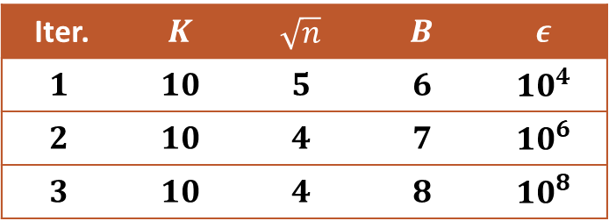
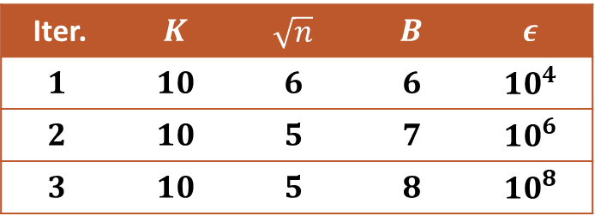
CASE STUDY 1: KNOWN REAL IMAGE
Berkeley Collection: 26 images
Used masks: Random, 80 % missing pixels
SOP Restoration
Group (A)
Group (B)
Iter. | $$K$$ | $$\sqrt{n}$$ | $$B$$ | $$ε$$
$$1$$ | $$10$$ | $$5$$ | $$6$$ | $${10}^{4}$$
$$2$$ | $$10$$ | $$4$$ | $$7$$ | $${10}^{6}$$
$$3$$ | $$10$$ | $$4$$ | $$8$$ | $${10}^{8}$$
Iter. | $$K$$ | $$\sqrt{n}$$ | $$B$$ | $$ε$$
$$1$$ | $$10$$ | $$6$$ | $$6$$ | $${10}^{4}$$
$$2$$ | $$10$$ | $$5$$ | $$7$$ | $${10}^{6}$$
$$3$$ | $$10$$ | $$5$$ | $$8$$ | $${10}^{8}$$
Comparisons: TELEA and NS for both groups.
PSNR measure to evaluate the quality of the restorations.
ACA 2024
Notes:
Alexandru Telea (2004), based on the Fast Marching method, The main idea is to propagate the information from the boundary of the incomplete zones to their interior, completing each pixel using an average with weights of the elements in its neighborhood of given radius. Once a pixel is restored, it is moved to the next pixel using the fast marching method. To refer to this restoration, the acronym TELEA is used instead.
The second type of restoration is the one developed by the authors Bertalmio, Marcelo, Andrea L. Bertozzi, and Guillermo Sapiro around 2001 [3]. It should be remembered that this work is based on the partial differential equations (PDE) of fluid dynamics. Being considered a heuristic, the strategy is to travel along the edges of the complete zones to the incomplete zones. The isophotes1 are followed to the extent that they coincide with the gradient vectors of the boundary of the subregion to be restored. Some methods of fluid dynamics are used for this purpose. Once the set of points to be restored is obtained, they are completed with values that reduce the minimum variance in their given radius neighborhood. Analogously, to abbreviate the name of this scheme, NS is used instead.

Slide 14
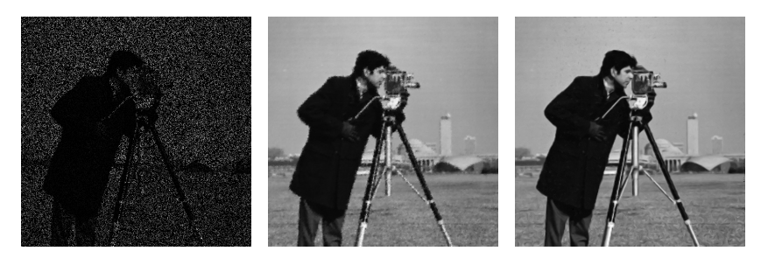
RESULTS CASE STUDY 1: REAL KNOWN IMAGE
PSNR Measurement Averages
Group | Iter. 1 | Iter. 2 | Iter. 3 | TELEA | NS
(A) | 26.89 | 28.80 | 29.39 | 24.36 | 27.20
(B) | 22.20 | 23.06 | 23.38 | 21.70 | 22.72
Corrupt image
NS
Iteration 3
ACA 2024
Notes:
The term peak signal-to-noise ratio (PSNR) is an expression for the ratio between the maximum possible value (power) of a signal and the power of distorting noise that affects the quality of its representation. Because many signals have a very wide dynamic range, (ratio between the largest and smallest possible values of a changeable quantity) the PSNR is usually expressed in terms of the logarithmic decibel scale.
Image enhancement or improving the visual quality of a digital image can be subjective. Saying that one method provides a better quality image could vary from person to person. For this reason, it is necessary to establish quantitative/empirical measures to compare the effects of image enhancement algorithms on image quality. Using the same set of tests images, different image enhancement algorithms can be compared systematically to identify whether a particular algorithm produces better results. The metric under investigation is the peak-signal-to-noise ratio. If we can show that an algorithm or set of algorithms can enhance a degraded known image to more closely resemble the original, then we can more accurately conclude that it is a better algorithm.

Slide 15
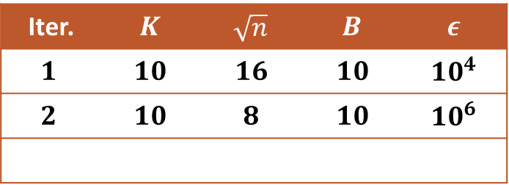
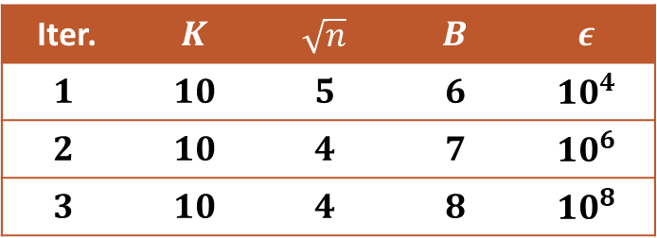
CASE STUDY 2: UNKNOWN REAL IMAGE
Colposcopy images of the cervix real image not known.
Masks used, define the gloss areas to be removed and restored.
SOP Restoration
Group (C)
Group (D)
Iter. | $$K$$ | $$\sqrt{n}$$ | $$B$$ | $$ε$$
$$1$$ | $$10$$ | $$5$$ | $$6$$ | $${10}^{4}$$
$$2$$ | $$10$$ | $$4$$ | $$7$$ | $${10}^{6}$$
$$3$$ | $$10$$ | $$4$$ | $$8$$ | $${10}^{8}$$
Iter. | $$K$$ | $$\sqrt{n}$$ | $$B$$ | $$ε$$
$$1$$ | $$10$$ | $$16$$ | $$10$$ | $${10}^{4}$$
$$2$$ | $$10$$ | $$8$$ | $$10$$ | $${10}^{6}$$
Comparisons with TELEA and NS, for both groups visual assessments.
Comparisons with TELEA and NS, for both groups visual assessments.
ACA 2024

Slide 16
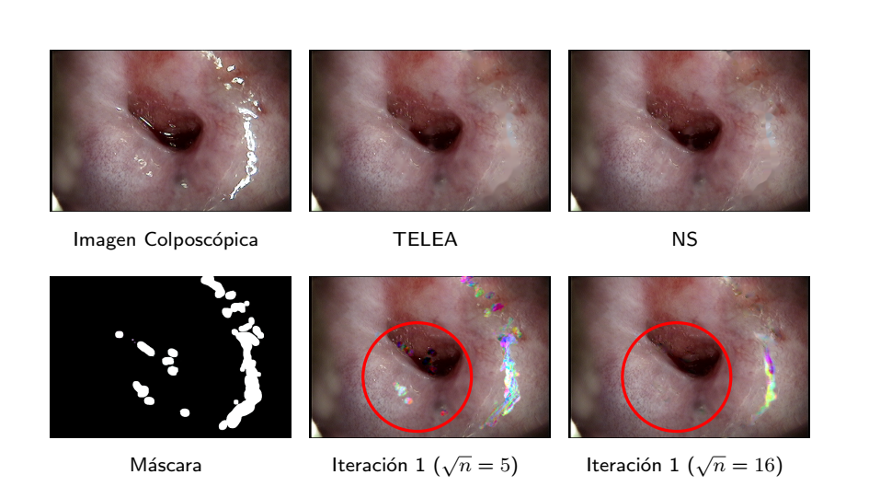


RESULTS CASE STUDY 2: UNKNOWN REAL IMAGE
Colposcopic image
TELEA
NS
Mask
Iteration 1 $\sqrt{n}=5$
Iteration 1 $\sqrt{n}=16$
ACA 2024

Slide 17
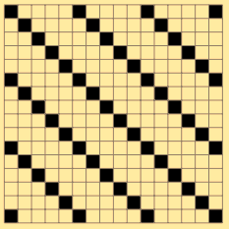



TWO NEW APPLICATIONS PROPOSED AFTER STUDY AND RESULTS OF THE ALGORITHM
IMAGE COMPRESSION
Image Compression - $t$-diagonal masks
$$m_{ij}= \left\{\begin{aligned}0 \\ 255\end{aligned}\right.$$
if
$$t|(i−j)$$
else
$$N_{c}<\frac{N}{t}+1$$
ACA 2024

Slide 18
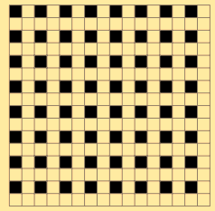

TWO NEW APPLICATIONS PROPOSED AFTER STUDY AND RESULTS OF THE ALGORITHM
IMAGE COMPRESSION
Image Compression - $t$-diagonal masks
$$m_{ij}= \left\{\begin{aligned}0 \\ 255\end{aligned}\right.$$
if i and j are odd
else
ACA 2024

Slide 19
TWO NEW APPLICATIONS PROPOSED AFTER STUDY AND RESULTS OF THE ALGORITHM
DENOISING
Noise characteristics in images
Use tool to detect noise and obtain noise mask
ACA 2024

Slide 20
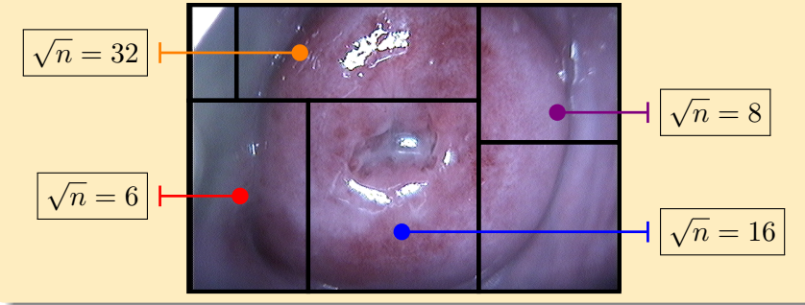
TWO NEW APPLICATIONS PROPOSED AFTER STUDY AND RESULTS OF THE ALGORITHM
ADAPTATIVE ALGORITHM
ACA 2024

Slide 21
FINAL REMARKS
The SOP restoration far outperformed TELEA and NS, and at the same time proved how successful it is to perform consecutive restorations.
In the second case study, colposcopic images were used, which have specular reflections areas to be removed, but their non-glossy version is unknown. The SOP restoration was not effective in the experimentation performed, unlike TELEA and NS, which showed good performance.
As a result of this study, an adaptive strategy was proposed that allows SOP restoration to be applied to colposcopy images.
SOP restoration is effective in images where the missing pixels are uniformly distributed in the image.
The SOP scheme with consecutive restoration could be applied to image compression, enhancement and denoising.
ACA 2024
Notes:
Using TELEA, NS and the quality metric PSNR as reference restorations, the first case study (ground thruth or original image known and misinformation uniformly distributed) demonstrated the effectiveness of SOP on a certain set of images. The SOP restoration far outperformed TELEA and NS, and at the same time proved how successful it is to perform consecutive restorations.
An adaptive zonal strategy, which is proposed in the paper, would be the way to avoid the restoration of parts with empty patches and even determine the appropriate size of them in each zone of the image. This strategy allows dividing the restoration into sub-restorations where it becomes easier to use larger parameters of Algorithm 1 that improve the quality of the restoration. Analyzing this, related to the computational cost, it was explained that if the size of the patches is increased, as suggested by the experiment, the temporal cost increases and the memory requirements. However, it was further explained, the temporal cost is invariant with respect to the total area of the areas to be recovered. As a result of this study, an adaptive strategy was proposed that allows SOP restoration to be applied to colposcopy images.

Slide 22
FURTHER DIRECTIONS
To experiment with a larger volume of images in both study cases.
To take into account different configurations of parameters that allow to analyze in depth the influence of each one on the quality of the restoration.
To carry out research on the applications proposed in section 4.3, such as:
To use SOP and its variants not only for inpainting but also to increase the resolution of images and to eliminate the noise.
To implement the adaptive strategy for colposcopy images and to perform a large enough experimentation.
To analyze whether the computational costs of Algorithm 1 (smooth reordering of the patches) can be improved, or to look for alternatives to solve the TSP problem more efficiently by means of other algorithms.
ACA 2024
Notes:
On the other hand, the application of SOP to the elimination of noise in the images is proposed. For this purpose, a tool that detects the noise and generates a mask that defines it must be available. By means of this mask, the restoration is performed and the noise is eliminated. The very nature of noise in images has the property of being uniformly distributed and without forming large areas of misinformation. The results of the experiment for case study 2 showed the most important disadvantages of the SOP scheme. Empty patches represent a problematic case, as their centers fail to restore correctly. A value of √n large enough to minimize the number of empty patches should be used. Also, when the area to be restored is small relative to the whole image, a lot of unnecessary computational time is wasted. Therefore, a simple solution is to select a smaller rectangular subregion containing all the areas to be restored. Now, using both considerations, both the patch size and the idea of reducing the image to a smaller rectangular subregion, an adaptive strategy for using SOP in colposcopy images can be designed.

Slide 23
IMAGE INPAINTING USING THE SMOOTH ORDERING OF ITS PATCHES (SOP): TWO NEW APPLICATIONS
Daniel García Perez, Marta Lourdes Baguer Daz-Romañach, Manuel Vilas Valiente
ACA 2024

